Slide 1
Model-Driven Test Design CS 4501 / 6501 Software Testing

Slide 2
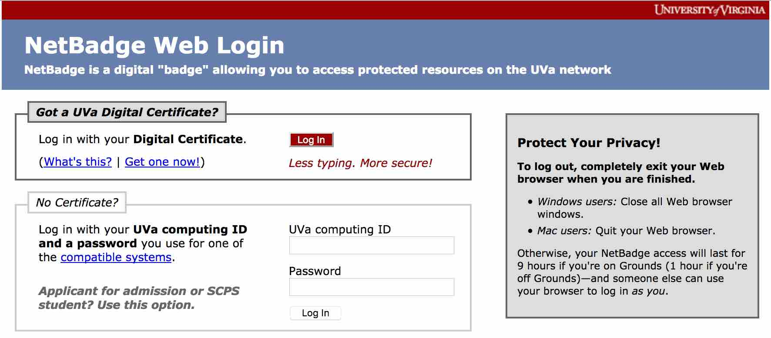


Complexity of Testing Software
✓
11 * 11 = 121
1111 * 1111 = 1234321
111111 * 11111 = 1245654321
✓
Correctness
✘
✓
✘
?
✓
✘
?

Slide 3
Testing and SW Development Lifecycle
Requirements
Analysis
Acceptance
Test
Validation
Test
Design
Information
Architectural
Design
System
Test
Subsystem
Design
Integration
Test
Detailed
Design
Module
Test
Verification
Implementation
Unit
Test
[AO, p.23]

Slide 4
Old View: Colored Boxes
Black-box testing
Derive tests from external descriptions of the software, including specifications, requirements, and design
White-box testing
Derive tests from the source code internals of the software, specifically including branches, individual conditions, and statements
Model-based testing
Derive tests from a model of the software (such as a UML diagram)
Model-Driven Test Design
Makes the distinctions less important by focusing on “from what abstraction level do we derive tests?”

Slide 5
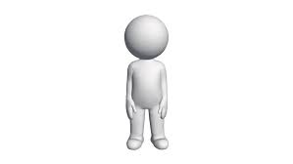
Software Testing Activities
Test
Manager
Test
Engineer
automate
1. Test
Design
2. Test
Automation
3. Test
Execution
design
instantiate
Test
Engineer
Computer
P
analyze
execute
Test
Engineer
4. Test
Evaluation
Output

Slide 6
1. Test Design
Human-based approach
Criteria-based approach
Design test values based on
Domain knowledge of the program
Human knowledge of testing
Knowledge of user interface
Require almost no traditional CS degree
Background in the software domain is essential
Empirical background is very helpful (biology, psychology, …)
Logic background is very helpful (law, philosophy, math, ...)
Design test values to satisfy coverage criteria
The most technical job in software testing
Require knowledge of
Discrete math
Programming
Testing
Require much of a traditional CS degree
Using people who are not qualified to design tests will result in ineffective tests

Slide 7
Coverage Criteria
Even a small program has a huge number of possible inputs
Testers search a huge input space -- to find the fewest inputs that will reveal the most problems
Coverage criteria give structured, practical way to search the input space
Advantages of coverage criteria
Search the input space thoroughly
No much overlap in the tests
Maximize the “bang for the buck”
Provide traceability from software artifacts
Make regression testing easier
Provide a “stopping rule” … when to stop testing
Can be well supported with tools

Slide 8
Test Criteria and Requirements
Test criterion: A collection of rules and a process that define
test requirements
Cover every statement
Cover every functional requirement
Test requirements: Specific things that must be satisfied or
covered during testing
Each statement might be a test requirement
Each functional requirement might be a test requirement
Input domains
Graphs
Logic expressions
Syntax descriptions
Many criteria have been defined. They can be categorized into 4 types of structures

Slide 9
2. Test Automation
Embed test values into executable scripts
Slightly less technical
Require knowledge of programming
Require very little theory
Often involve observability and controllability issues
Can be boring for test designers
Programming is out of reach for many domain experts
Who is responsible for determining and embedding the expected outputs?
Test designers may not always know the expected outputs
Test evaluators need to get involved early to help with this

Slide 10
3. Test Execution
Run tests on the software and record the results
Easy and trivial if the tests are well automated
Requires basic computer skills
Interns
Employees with no technical background
Can be boring for test designers
Asking qualified test designers to execute tests is a sure way to convince them to look for a development job
Test executors have to be very careful and meticulous with bookkeeping

Slide 11
4. Test Evaluation
Evaluate results of testing, report to developers
This is much harder than it may seem
Requires knowledge of
Domain
Testing
User interfaces and psychology
Usually requires almost no traditional CS
Background in the software domain is essential
Empirical background is very helpful (biology, psychology, …)
Logic background is very helpful (law, philosophy, math, ...)

Slide 12
Other Activities
Test management
Sets policy, organizes team, interfaces with development, chooses criteria, decides how much automation is needed, …
Test maintenance
Save tests for result as solve evolve
Requires cooperation of test designers, engineers responsible for test automation
Partly policy and partly technical
Test documentation
All parties participate
Each test must document “why” -- criterion and test requirement satisfied or a rationale for human-designed test
Ensure traceability throughout the process
Keep documentation in the automated tests

Slide 13
Organizing the Team
A mature test organization needs only one test designer to work with several test automators, executors, and evaluators
Improved automation will reduce the number of test executors
Putting the wrong people on the wrong tasks leads to inefficiency, low job satisfaction and low job performance
A qualified test designer will be bored with other tasks and look for a job in development
A qualified test evaluator will not understand the benefits of test criteria
Test evaluators have the domain knowledge, so they must be free to add tests that “blink” engineering processes will not think of
The four test activities are quite different

Slide 14
Model-Driven Test Design
Breaks testing into a series of small tasks that simplify test generation
Isolate each task
Work at a higher level of abstraction
Use mathematical engineering structures to design test values independently of the details of software or design artifacts, test automation, and test execution
Key intellectual step: test case design
Test case design can be the primary factor determining whether tests successfully find failures in software
Tests can be designed with
Human-based approach
Criteria-based approach

Slide 15
Using MDTD in Practice
This approach lets one test designer do the math
Then traditional testers and programmers can do their part
Find values
Automate the tests
Run the tests
Evaluate the tests
Test designers become technical experts
Many test designers get involved in crowd testing

Slide 16
Model-Driven Test Design
refined requirements / test specs
model / structure
test requirements
test requirements
DESIGN
ABSTRACTION
LEVEL
IMPLEMENTATION
ABSTRACTION
LEVEL
software artifact
input values
pass / fail
test results
test scripts
test cases
[AO, Ch2-mdtd]

Slide 17
Model-Driven Test Design - Steps
criterion
refine
refined requirements / test specs
model / structure
test requirements
generate
analysis
test requirements
domain analysis
DESIGN
ABSTRACTION
LEVEL
IMPLEMENTATION
ABSTRACTION
LEVEL
software artifact
input values
feedback
evaluate
execute
automate
prefix
postfix
expected
pass / fail
test results
test scripts
test cases
[AO, Ch2-mdtd]

Slide 18
Model-Driven Test Design–Activities
refined requirements / test specs
model / structure
test requirements
Test Design
DESIGN
ABSTRACTION
LEVEL
Raising our abstraction level makes
test design MUCH easier
IMPLEMENTATION
ABSTRACTION
LEVEL
software artifact
input values
Test Automation
pass / fail
test results
test scripts
test cases
Test Evaluation
Test Execution
[AO, Ch2-mdtd]

Slide 19
Types of Activities We’ll focus
Test Design
with Criteria-based Approach

